Slide 1
Network propagation for evaluating Big Mechanism

Slide 2
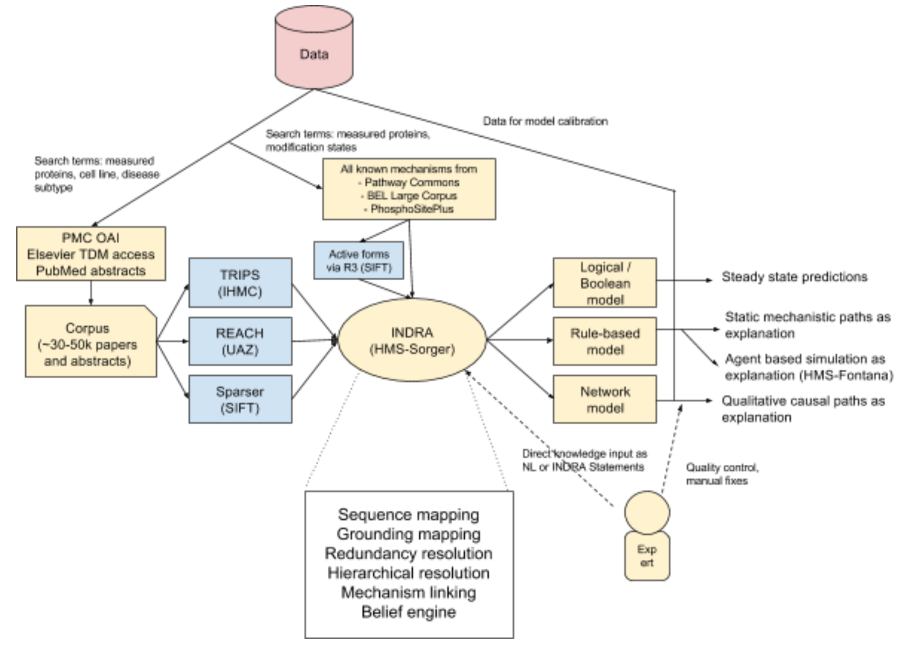
INDRA (Integrated Network and Dynamical Reasoning Assembler)

Slide 3
Test set: Molinelli et al. (Sanders Lab)

Slide 4
Approach
Network propagate from the drug targets to guess at the most genes most likely to be effected by the drug perturbation
Compare the predictions from network propagation with the actual (absolute value) of phosphoprotein changes

Slide 5
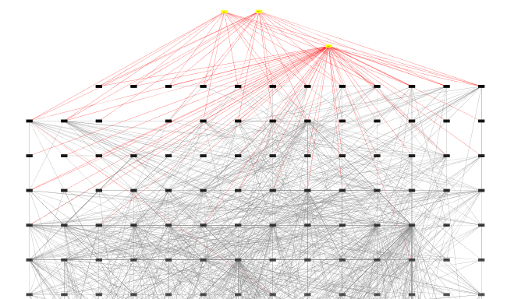
AKT inhibitors diffused on the prior network

Slide 6
Lessons from performance
Single drugs were easier to predict than drug pairs
Larger doses were much easier to predict than smaller doses
Easier drug to predict: AKT inhibitors, MEK inhibitors, PI3K
Hard to predict: HDAC inhibitors, JAK-Stat paths targets

Slide 7
Performance by Drug
Drug name | Target | HGNC target | Downstream effector | HGNC downstream | Prior | Proir + Lit
AKTi 1/2 | AKT | AKT1,AKT2,AKT3 | AKTpS473 | no_gene | 0.68 | 0.24
Temsirolimus | mTOR | MTOR | S6pS240 | RPS6 | 0.35 | -0.01
ZSTK474 | PI3K | PIK3CA,PIK3CB,PIK3R1 | AKTpS473 | AKT1,AKT2,AKT3 | 0.53 | -0.42
PD0325901 | MEK1/2 | MAP2K1,MAP2K2 | MAPK1pT202 | MAPK1,MAPK3 | 0.68 | 0.12
Stattic | STAT3 | STAT3 | STAT3pY705 | no_gene | 0.37 | -0.55
HNHA | HDAC | no_gene | P27/Kip1 | CDKN1B | 0.02 | -0.23
PLX4720 | BRAFV600E | BRAF | MAPK1pT202 | MAPK1 | 0.22 | 0.15
RO-31-7549 | PKC | PRKCA,PRKCB,PRKCD,PRKCE,PRKCH,PRKCQ | S6pS240 | no_gene | 0.22 | -0.34
RY | CDK4 | CDK4 | Rb_pS807 | RB1 | -0.06 | 0.05
P6 | JAK | JAK2 | GSK3pS21 | GSK3A,GSK3B | -0.6 | 0.23
SR | SRC | SRC | GSK3pS21 | GSK3A,GSK3B | 0.19 | -0.6
Nutlin | MDM2 | MDM2 | 4EBP1pS65 | EIF4EBP1 | 0.63 | 0.05

Slide 8
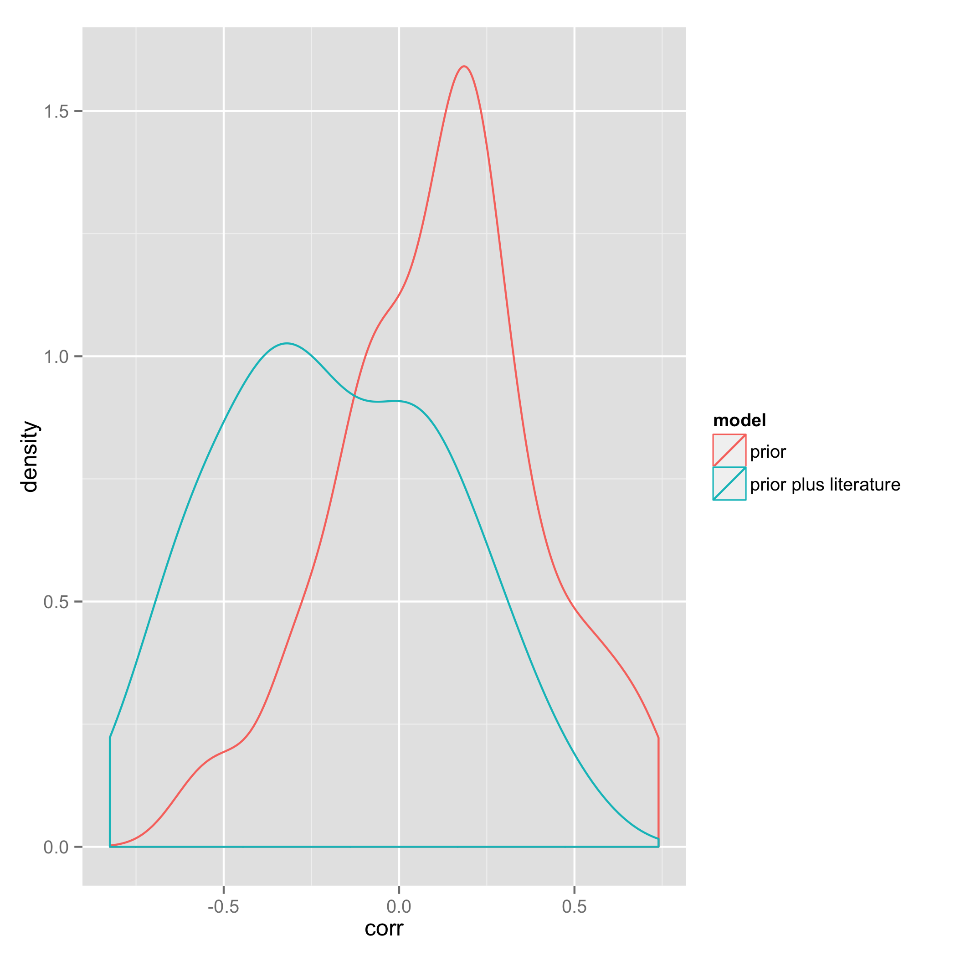

Slide 9
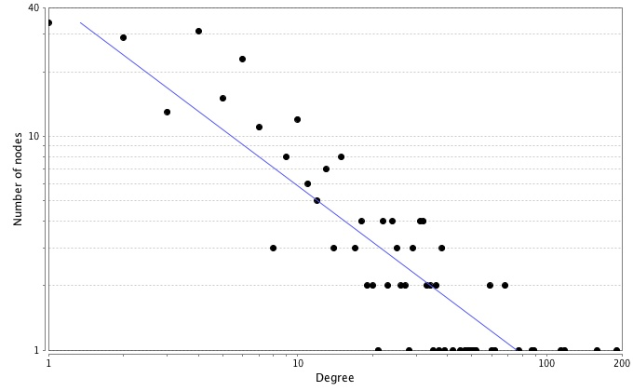
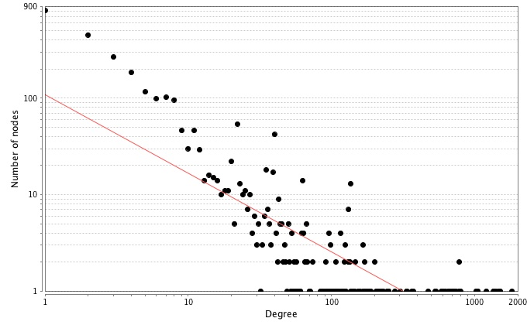
Prior
Prior + literature

Slide 10
Next steps
Need to reduce hubiness of important genes in prior
Make sure every gene is a member of the N shortest path between drug targets and probed phosphoproteins
Contextualization
Are these genes expressed in melanoma?

